Slide 1
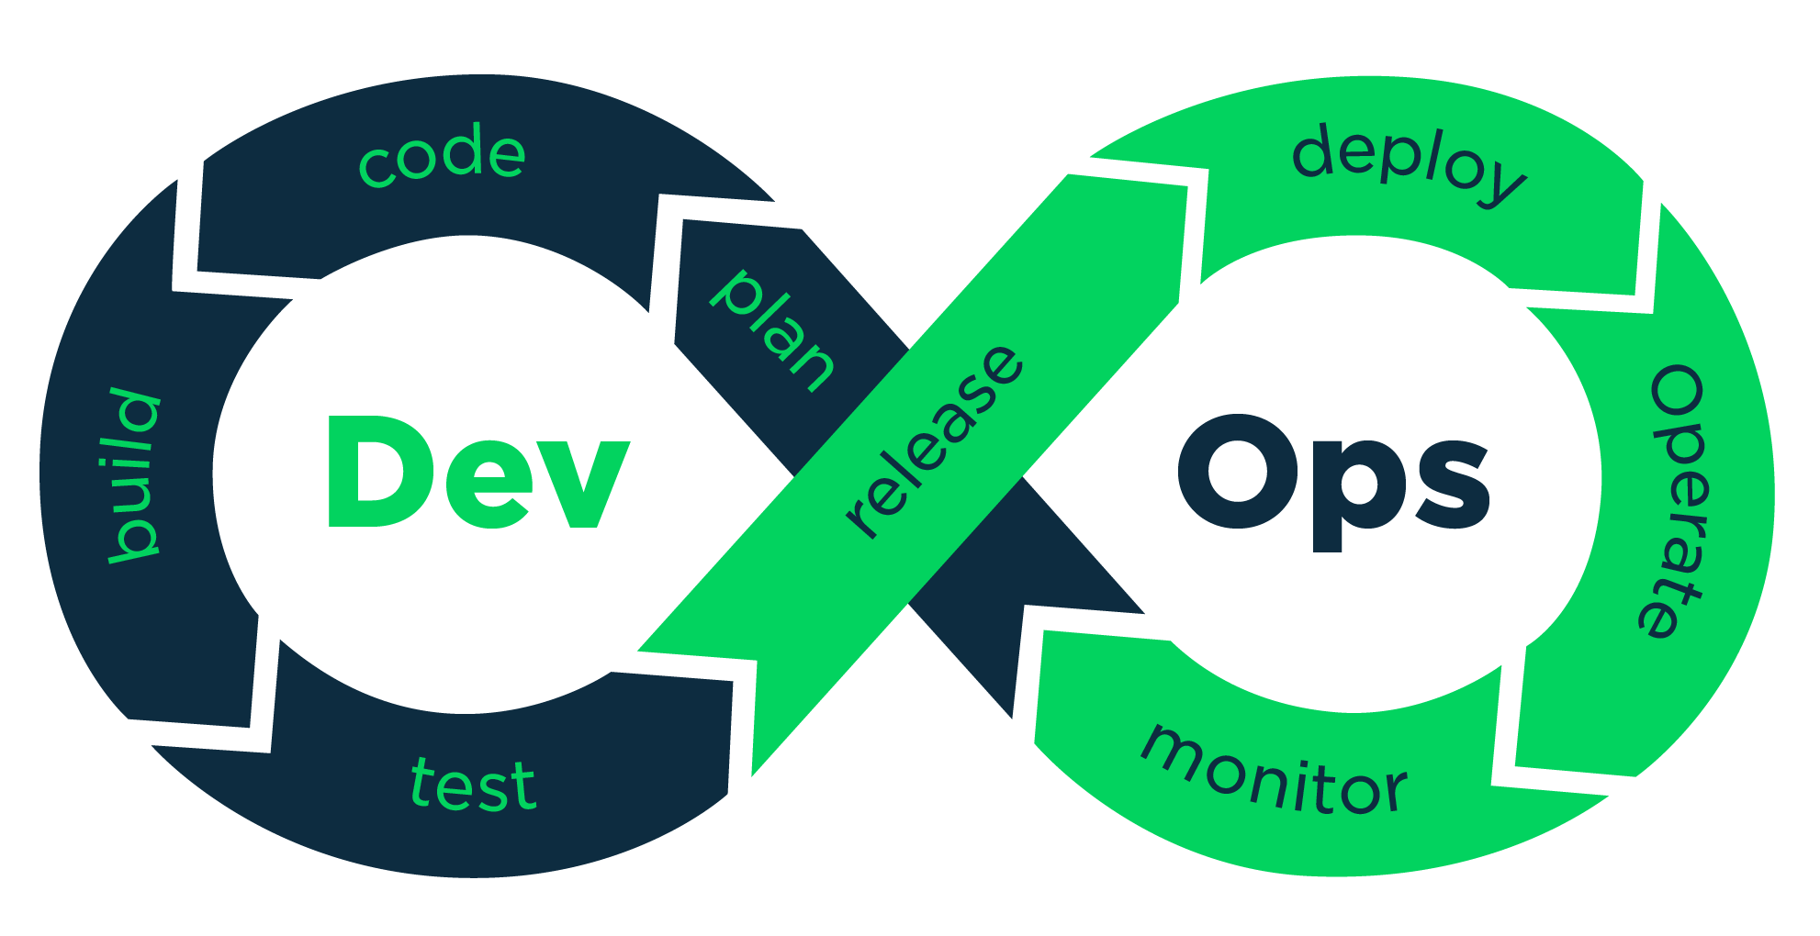
What is DevOps
Overview

Slide 2
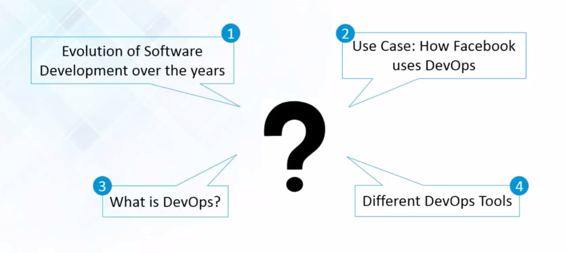
Do you know the following :

Slide 3
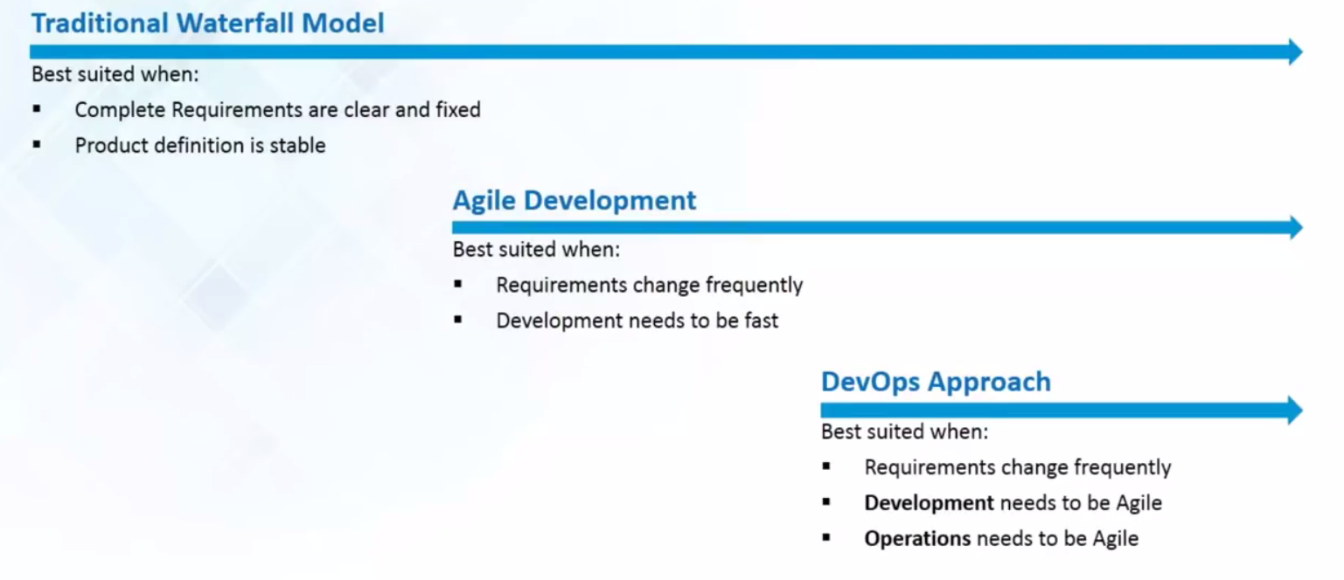
Evolution of Software Development

Slide 4
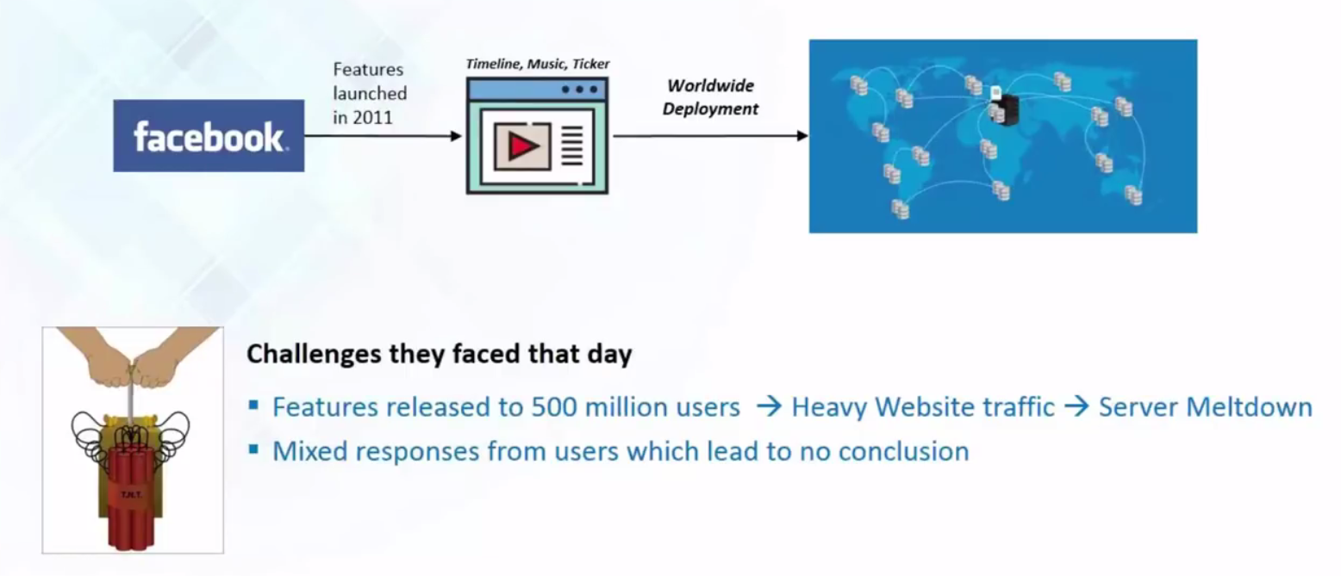
Use Case 2011 : FaceBook

Slide 5

Face Book Comes Up with Dark Launching

Slide 6
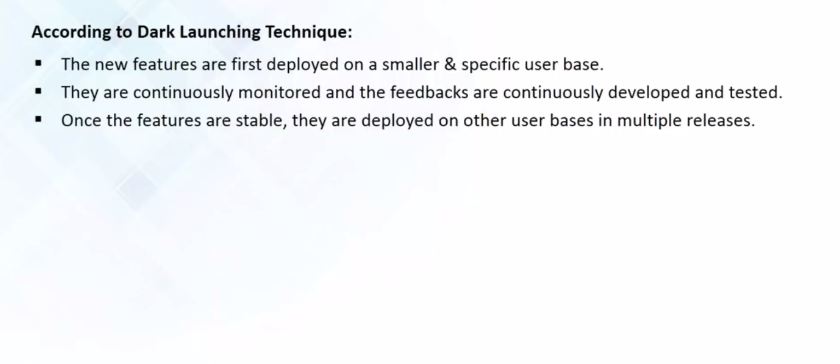
The Dark Launching Techinique

Slide 7
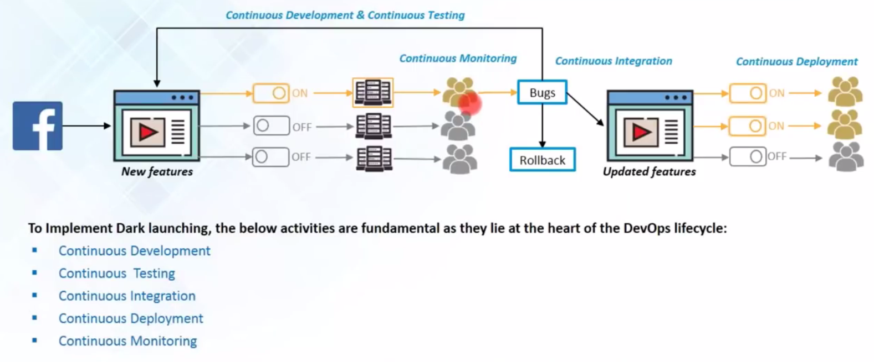
The Dark Launching Techinique

Slide 8
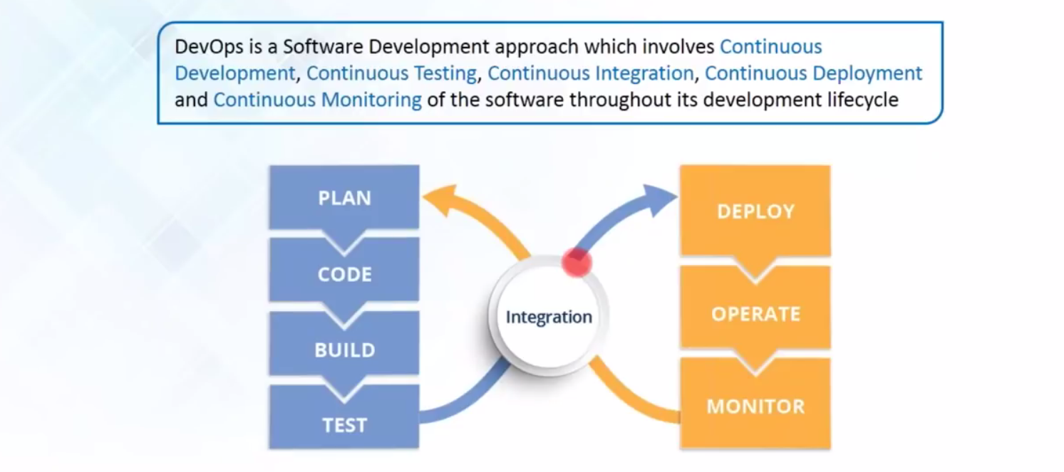
What is DevOps ?

Slide 9
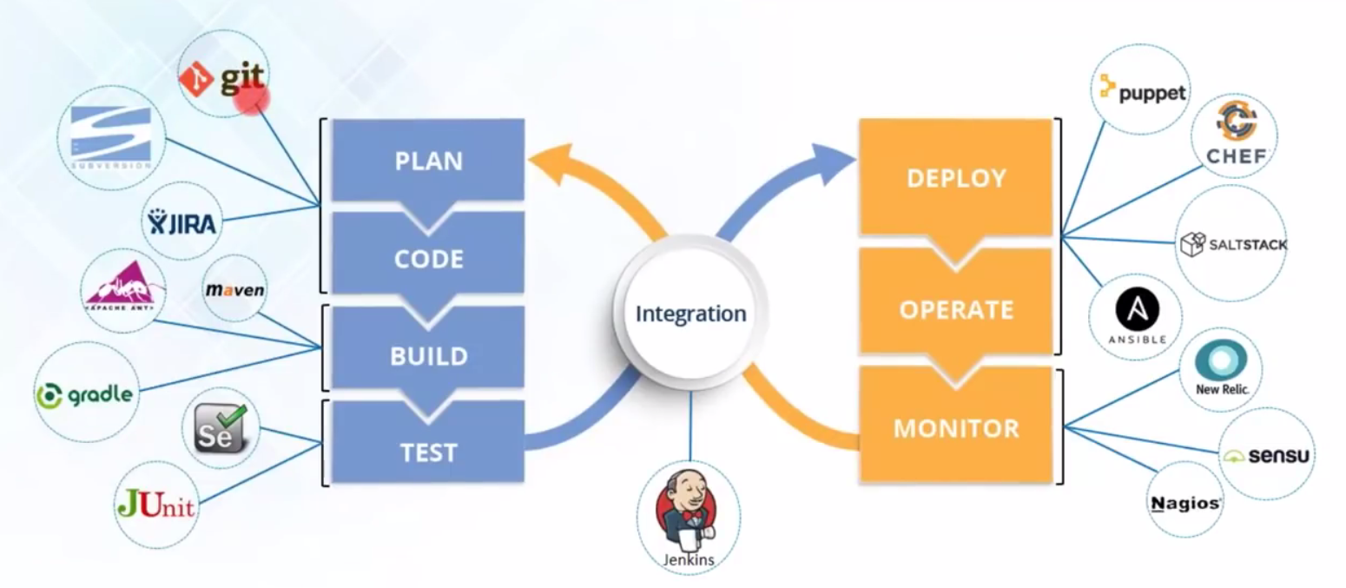
DevOps Tools

Slide 10


